Slide 1




Improved Machine Learning Pneumonia Detection System
Using Ensemble Learning

Slide 2
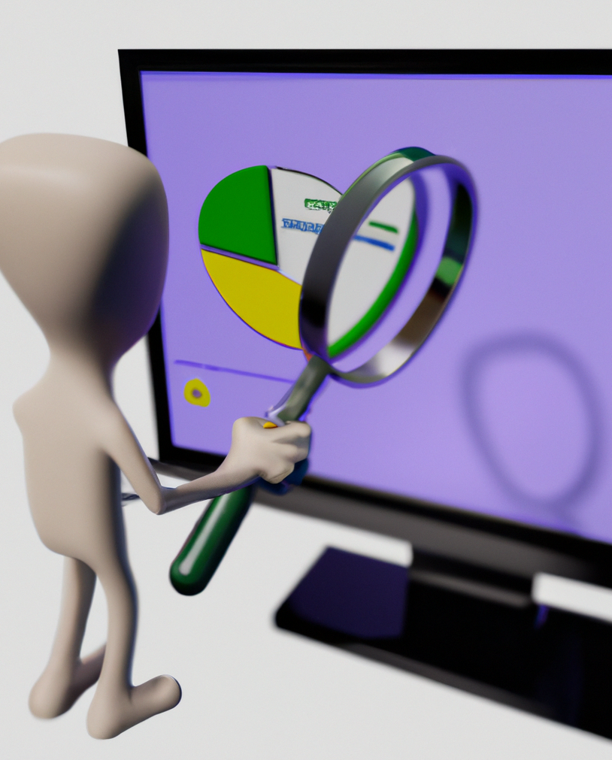
Introduction to Pneumonia Detection System
Pneumonia Detection has become a serious problem in today's society. In order to combat this, computer-aided classification approach, named Ensemble Learning (EL), for diagnosing pneumonia on chest X-ray images. This presentation will discuss the fundamentals of Pneumonia Detection and the various methods used by Ensemble Learning (EL), algorithms.
Pneumonia Detection is a complex task, as EL is based on three well-known pre-trained CNN models, namely DenseNet169, MobileNetV2, and Vision Transformer, which are fine-tuned on the chest X-ray dataset . The extracted features from these models are combined to obtain the final results.

Slide 3

Outline
Introduction to Project
Problem Formulation
Objective
Methodology Used
Results and Outputs
Conclusion
References

Slide 4
Currently, there are several common techniques used for detecting Pneumonia, including Sputum tests, Blood tests, and CT Scans. However, Blood tests can take a longer time to produce results, Sputum tests may be less accurate, and CT Scans can be prohibitively expensive for the average person. These factors motivated us to undertake this project, which aims to provide patients with a preliminary understanding of their health, thereby reducing costs and the need for multiple tests.
The goal is to develop a tool that can assist radiologists and other healthcare professionals in quickly and accurately diagnosing pneumonia, potentially reducing healthcare costs and improving patient outcomes.
Problem
Formulation

Slide 5
Objectives of this Project
The aim of this work is to create a system or model that can use the data of past news reports and predict the chances of a patient has pneumonia or not ?. Various researchers have attempted solving this challenge in a multitude of ways to test which method works and get desirable results.

Slide 6
Methodology Used
Support Vector Machine
Random
Forest
Model Validation
Support vector machines (SVMs) are a set of supervised learning methods used for classification, regression and outliers detection. The advantages of support vector machines are: Effective in high dimensional spaces. Still effective in cases where number of dimensions is greater than the number of samples.
Random forest combines the output of multiple decision trees to reach a single result. Its ease of use and flexibility have fueled its adoption, as it handles both classification and regression problems.
Validate the model using a separate dataset of chest X-rays or CT scans. The dataset should be separate from the training dataset to ensure the model's ability to generalize and avoid overfitting.

Slide 7
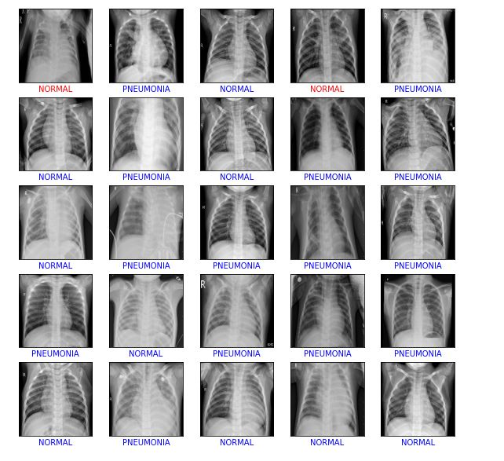
Methodology Used
The dataset was partitioned into two segments: a training dataset and a test dataset. The training dataset was utilized to train the CNN, while the test dataset was used to evaluate the system's performance. The CNN was trained on the training dataset using backpropagation to update the network's weights. The system's accuracy was calculated by evaluating it on the test dataset.
The collection contains only radiograph images at a resolution of 1024 by 1024. 1431 of these 112,120 pictures have been identified as having pneumonia. 1431 typical X-ray images have been chosen from the collection in order to balance the dataset for binary classification.
The dataset was then split into two halves, from which 573 photos were randomly chosen for testing from the entire final dataset. Before being input to the network, the photos were downscaled from 1024 by 1024 resolution to 224 by 224 resolution.

Slide 8
Results and Outputs
Convolutional Neural Networks (CNNs) are widely used for pneumonia detection because of their ability to automatically extract relevant features from medical images.
The visual appearance of pneumonia in chest X-ray images can vary widely depending on factors such as the patient's age, underlying health conditions, and the severity of the infection.
CNNs are well-suited to detecting such visual patterns in medical images because they are designed to learn hierarchical representations of the input data. CNNs consist of multiple layers of filters that convolve over the input image, learning local patterns in the image such as edges, corners, and textures.
These filters are then combined in higher layers to learn more abstract features such as shapes and objects. Finally, the output of the CNN is fed into one or more fully connected layers that classify the input image as either pneumonia-positive or pneumonia-negative.

Slide 9
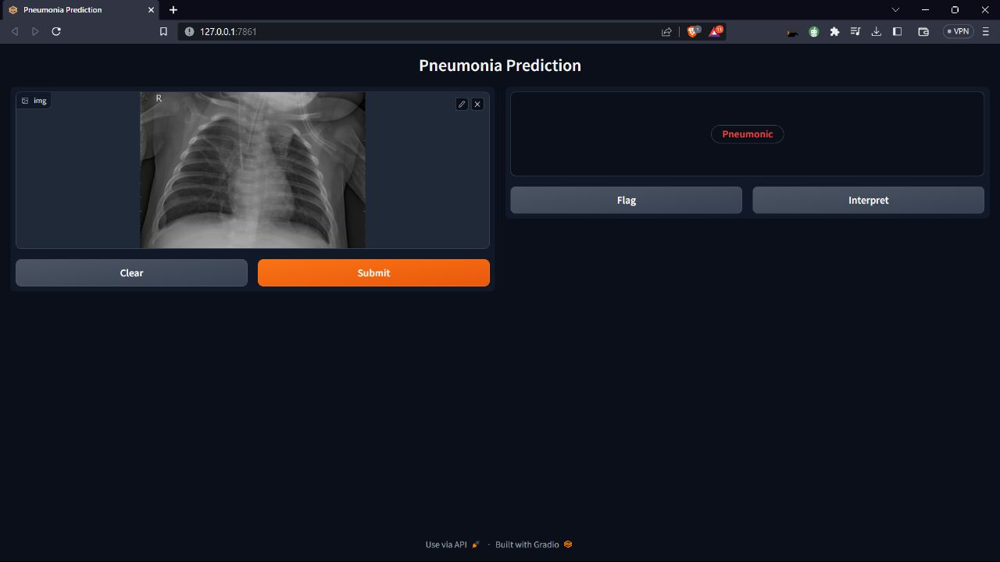
Results and Outputs

Slide 10
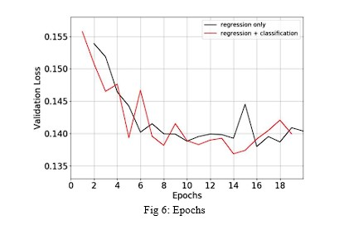
Results and Outputs
By using CNNs for pneumonia detection, we can develop a model that can automatically learn to detect the relevant visual patterns associated with pneumonia, without the need for manual feature extraction. This can reduce the time and effort required for pneumonia detection, as well as potentially increasing the accuracy and consistency of the diagnosis.

Slide 11
Conclusion
System developed in this research in an effective tool for recognizing Pneumonia using X rays. This system can be used by people who does not have time to go visit doctor. Or have money to visit doctor. This system can be used online easily by anyone. This system just need X ray image to detect Pneumonia free of charge in less then 1 min. This system have one limitation which is that the website interface link only works for 72 hours
each time because we are using gradio. This system can be improved by using Html to create website. This will ensure that the website link is permanent and does not expire. Also we can use better dataset to increase the accuracy of the system.

Slide 12
References
Kaiming He, Xiangyu Zhang, Shaoqing Ren, and Jian Sun. 2016. Deep residual learning for image recognition. In Proceedings of the
Alex Krizhevsky, Ilya Sutskever, and Geoffrey E Hinton. 2012. Imagenet classification with deep convolutional neural networks. In Advances in neural information processing systems.
Ali Sharif Razavian, Hossein Azizpour, Josephine Sullivan, and Stefan Carlsson. 2014. CNN features off-the-shelf: an astounding baseline for recognition. In Proceedings of the IEEE conference on computer vision and pattern recognition workshops
Kai-Lung Hua, Che-Hao Hsu, Shintami Chusnul Hidayati, WenHuang Cheng, and Yu-Jen Chen. 2015. Computer-aided classification of lung nodules on computed tomography images via deep learning technique. OncoTargets and therapy 8
Mohammad Tariqul Islam, Md Abdul Aowal, Ahmed Tahseen Minhaz, and Khalid Ashraf. 2017.
Pulkit Kumar, Monika Grewal, and Muktabh Mayank Srivastava. 2018. Boosted cascaded convnets for multilabel classification of thoracic diseases in chest radiographs. In International Conference Image Analysis and Recognition. Springer

